Slide 1

HINDU INSTITUTE OF MANAGEMENT
NAME – Shubham Dahiya
CLASS – B.C.A 1st year – 1st Sem.
Class Teacher – Vaishali Sharma
Topic- WHY is YOGA is becoming so POPULAR
Dated: 30.09.2020

Slide 2
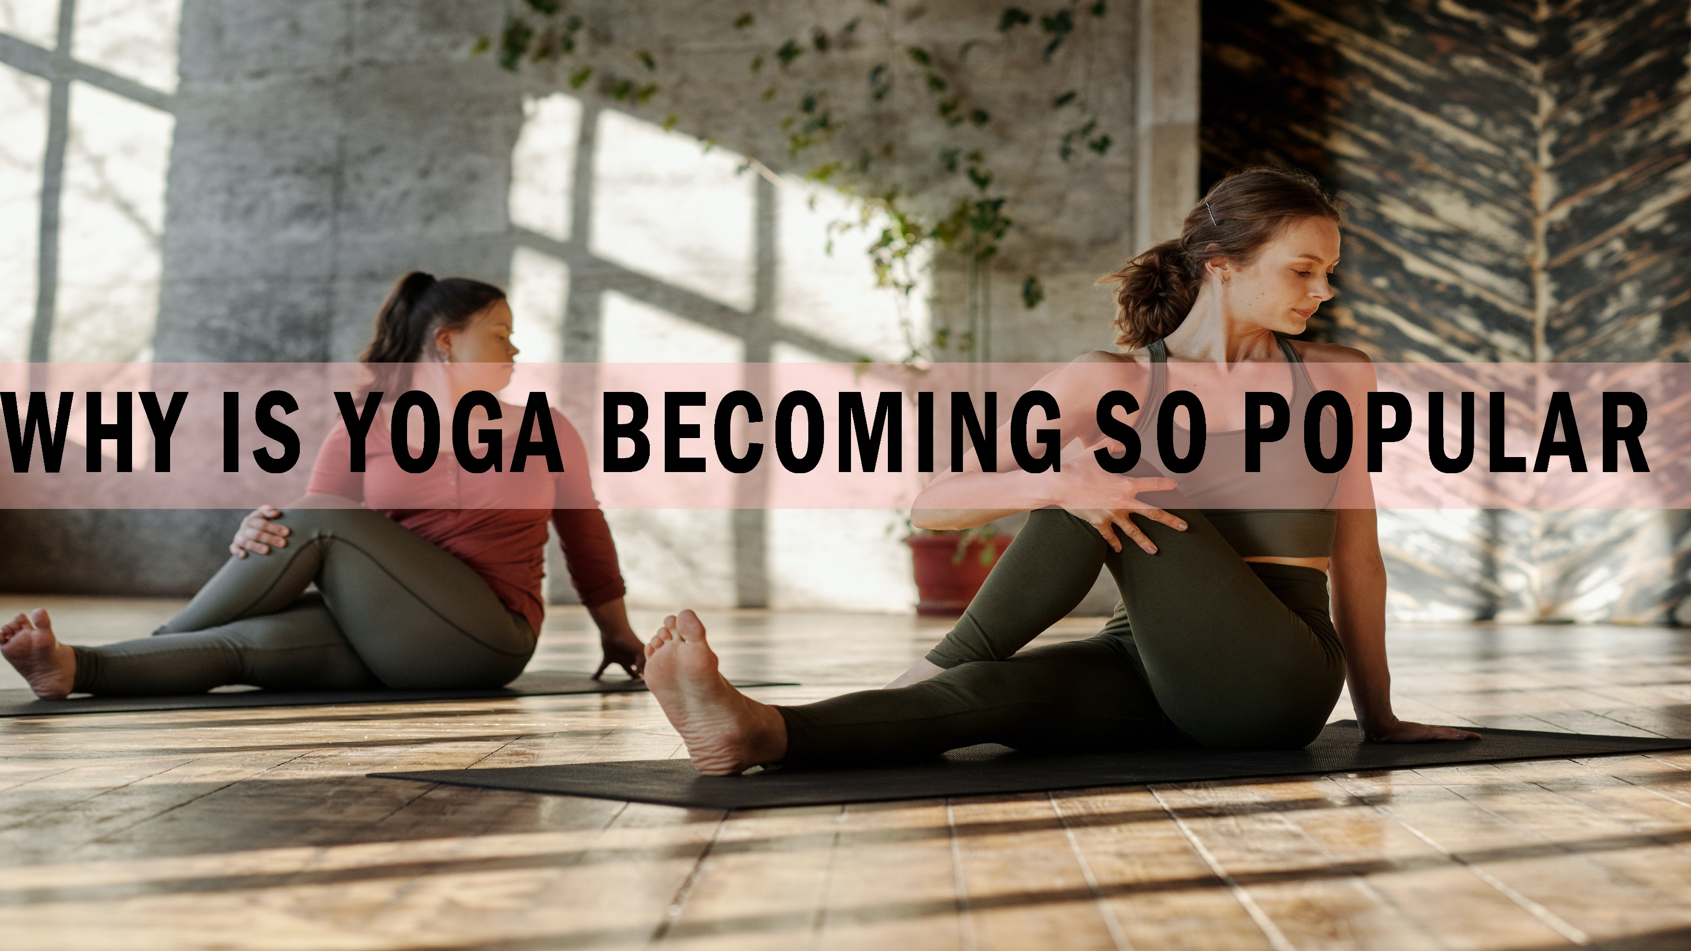

Slide 3

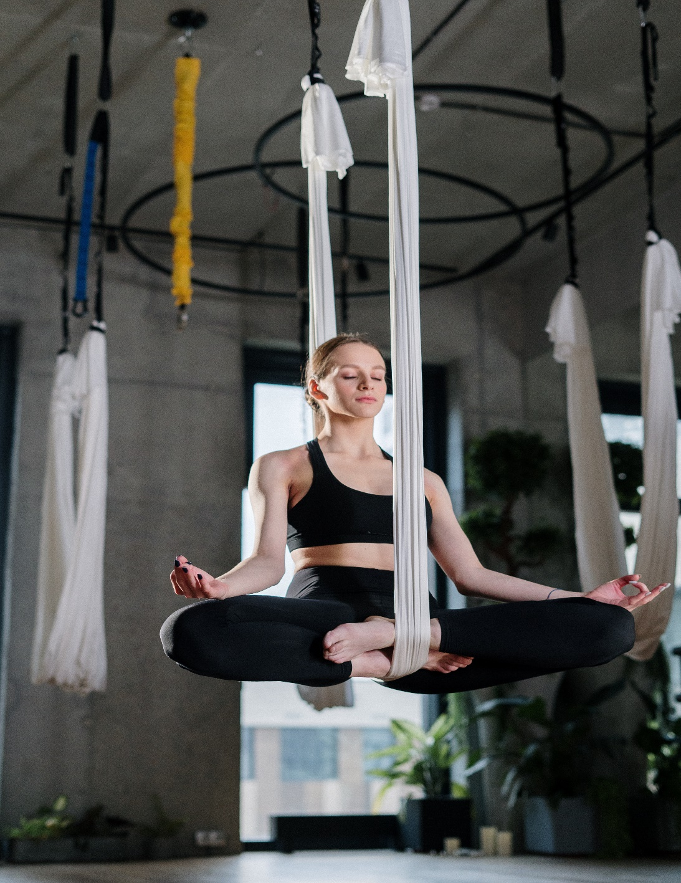
REASON
There are many reasons why yoga is becoming popular today. Your body is like a barometer, it makes you realize some fundamental facts about yourself. If you know how to watch it, it tells you everything about yourself. Not the fancy things that you think, but the real facts. Your mind is too deceptive; every day it says something different, but if you know how to read the body, it tells you everything just the way it is, your past, present and future. That is why fundamental yoga starts with the body

Slide 4

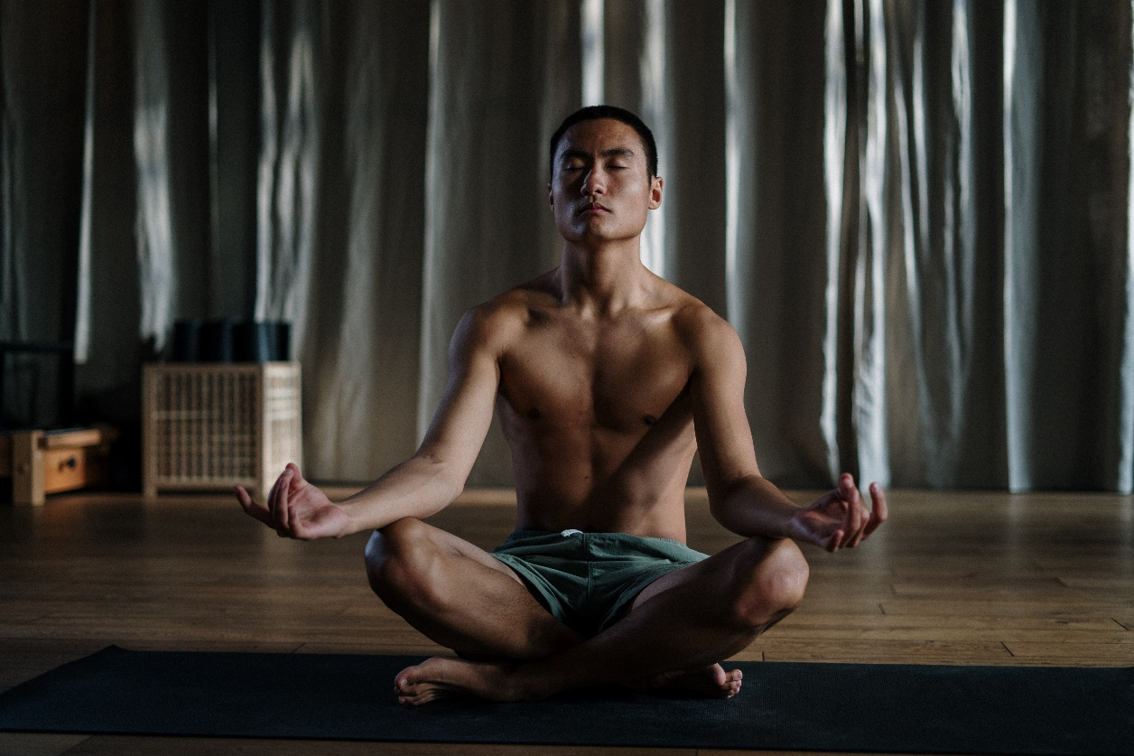
STILL ALIVE without any Enforcement
Yoga is the only system that has lived for over 15,000 years without any papacy or enforcement. Nowhere in the history of humanity has it happened that somebody put a sword to someone’s neck and said, “You must do yoga.” It has survived and lived on because it has worked as a process of wellbeing like nothing else. Even though today it is being taught in a very rudimentary or even distorted way, it still endures. Many things come and go with changing fashions, but yoga has survived for thousands of years, and it is still picking up momentum.

Slide 5

STILL growing POPULARITY
The main reason for yoga’s growing popularity is the large-scale transmission of education. Today, we have more intellect on this planet than ever before. As the intellect becomes stronger, people look for logical solutions. The more logical they become, the more they become dependent on science, and the outcome of science is technology. Yoga is not an exercise; it is an ancient technology towards wellbeing and ultimate liberation. As the activity of the intellect becomes stronger in the world, more people will shift to yoga over a period of time and it will become the most popular way of seeking wellbeing.

Slide 6
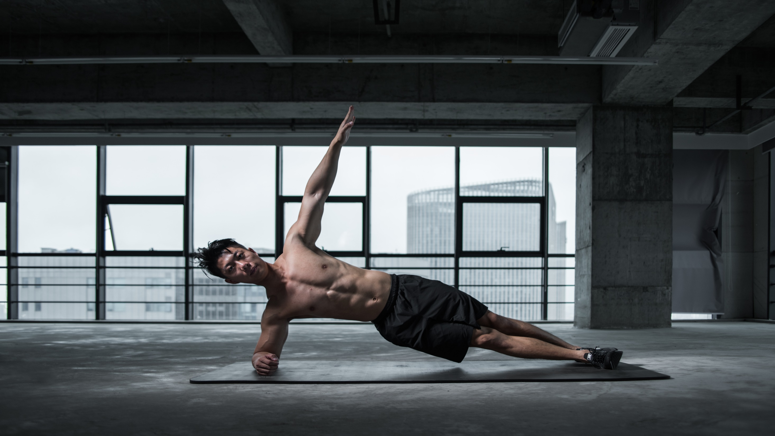
YOGA is NOT an EXERCISE

Slide 7
Yoga is Not an Exercise
Yoga needs to be practiced in a very subtle, gentle way, not in a forceful muscle building way, because it is not about exercise. The physical body has a whole memory structure. If you are willing to read this physical body, everything — how this cosmos evolved from nothingness to this point — is written into this body. Yoga is a way of opening up that memory and trying to restructure this life towards an ultimate possibility. It is a very subtle and scientific process

Slide 8


And Finally Thanks to
For giving me a chance to perform in the ACTIVITY held on 31-Sep.-2020
Signing off
-SHUBHAM DAHIYA

